Slide 1
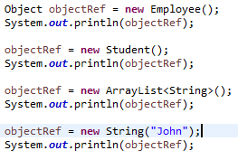
Object class in Java
The java.lang.Object class is the parent class of all the classes in java by default. In other words, it is the topmost class of java.
The java.lang.Object class is beneficial if you want to refer any object whose type you don't know. Notice that parent class reference variable can refer the child class object, know as upcasting.
we can use Object class reference to refer any type of objects like Employee, Student etc.

Slide 2
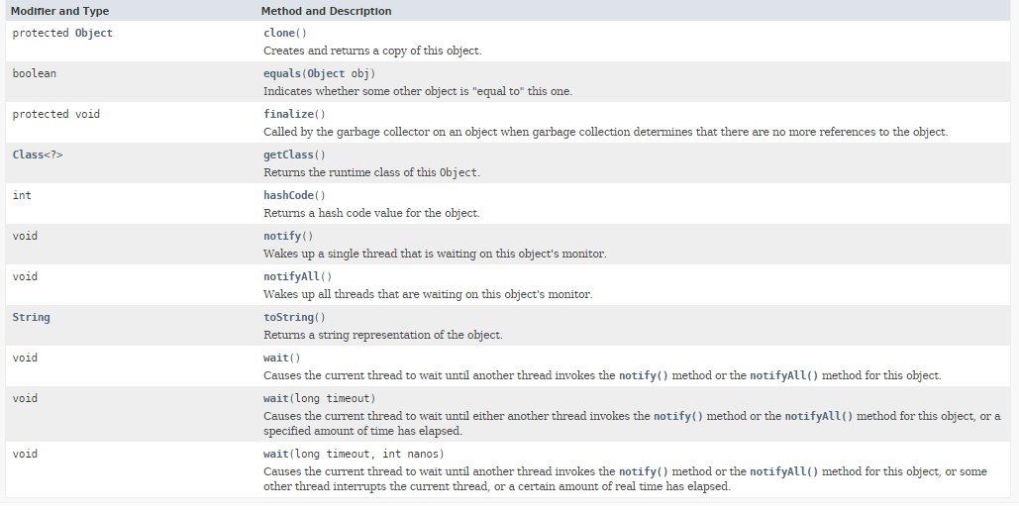
Object class in Java

